Slide 1

Team 6: Swapnil Kamate, Avadh Soni, Evan Mangone

Slide 2
Introduction
AutoHeaven aims to provide a user friendly online experience for its customers.
Through the use of social media and reviews, AutoHeaven wants to raise overall awareness for the benefits of purchasing EV cars.
The digital website of AutoHeaven will help the car buyers as it offers wide range of models and prices.

Slide 3
SWOT Analysis
Ease of Use
Responsive Customer Service
Skilled Labor Force
Brand Recognition
Lacking Business Partners
Low Profit Ratio
High R&D Costs
Low Cutting-edge Technology
Low Interest Rates
Poor Job Market
Marketing Campaigns
Security Issues
Use of Big Data
Ride Hailing Services
Reduced Cost of Inputs
Many Competitors
Strength
Weaknesses
Opportunities
Threats

Slide 4
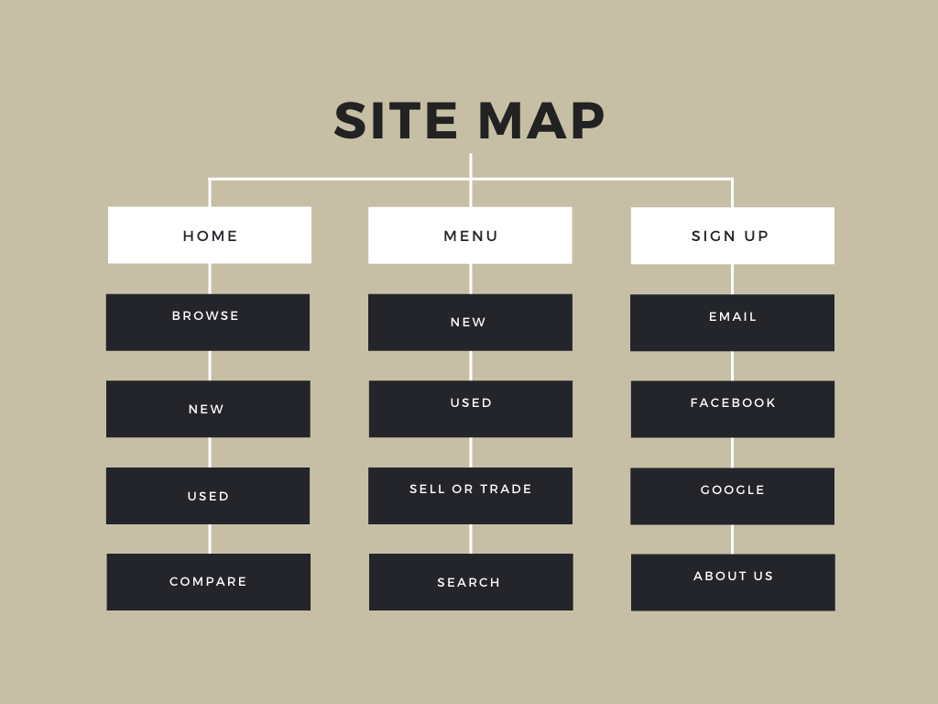

Slide 5
Business Rules
Make to Model (1:M)
A car company (make) will have many car models.
A particular model belongs to a specific car company (make).
Seller to used cars (1:M)
A seller can have multiple used cars (optional).
A used car should have only one seller.
*a seller is existence dependent on having a used car to sell
Car to Engine (1:1)
A car will have only one unique engine.
An engine belongs to only one specific car
*a car is existent dependent on an engine
Car to Specification Settings (M:M)
A car can be customized with many different specification settings (optional).
All the specifications can be used for many different cars (optional).
Car to License plate (1:1)
A car will have only one license plate.
A license plate will belong to one car.
Customer to Invoice (1:M)
A Customer can have many billing invoices (optional).
But an invoice will belong to a particular customer.
Vehicle to Location (1:M)
A vehicle will have one location.
A location will have many vehicles.
*a vehicle is existence dependent on a location

Slide 6
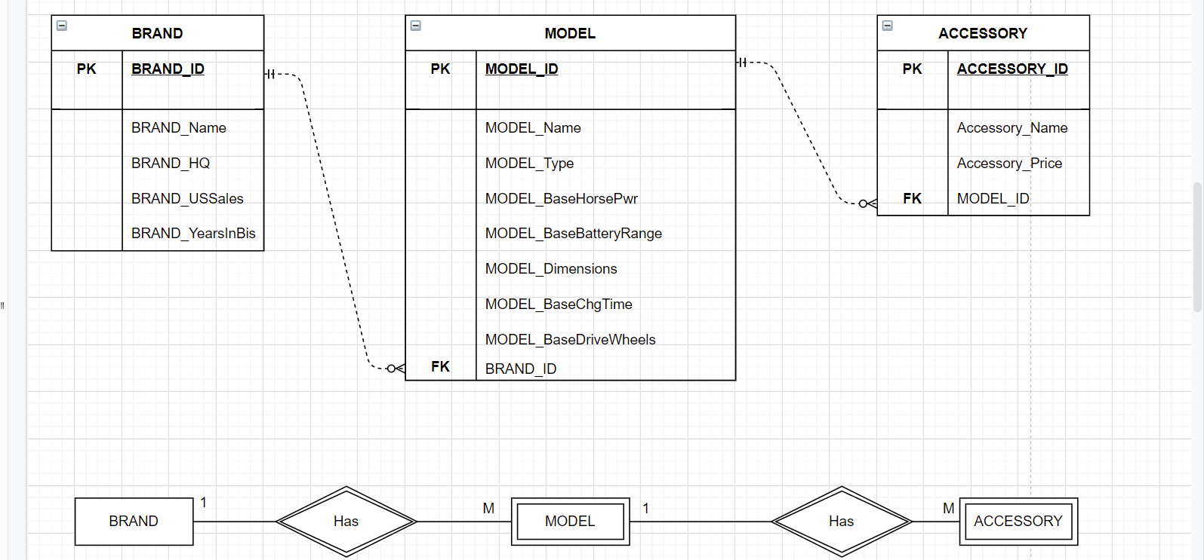
ER Diagram
Notes:
Every Attribute under model doesn’t change within the model - that is the reason we have basehorse power

Slide 7
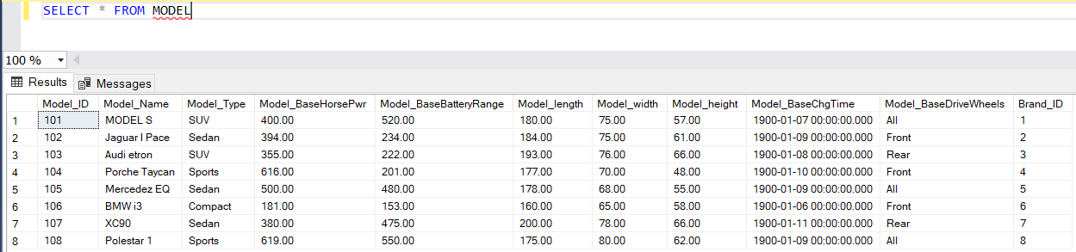
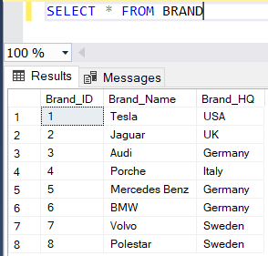
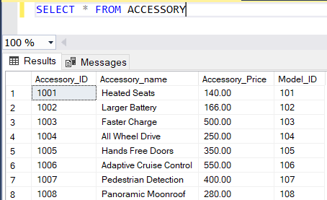
Data Tables
Model
Brand
Accessory

Slide 8
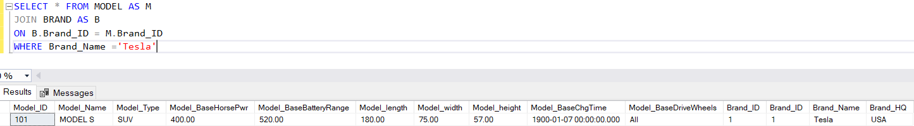
Data Retrieval
When the user clicks on a certain brand (let’s say Tesla) then the models for that specific brand is displayed
SELECT * FROM MODEL AS M
JOIN BRAND AS B
ON B.Brand_ID = M.Brand_ID
WHERE Brand_Name ='Tesla'

Slide 9
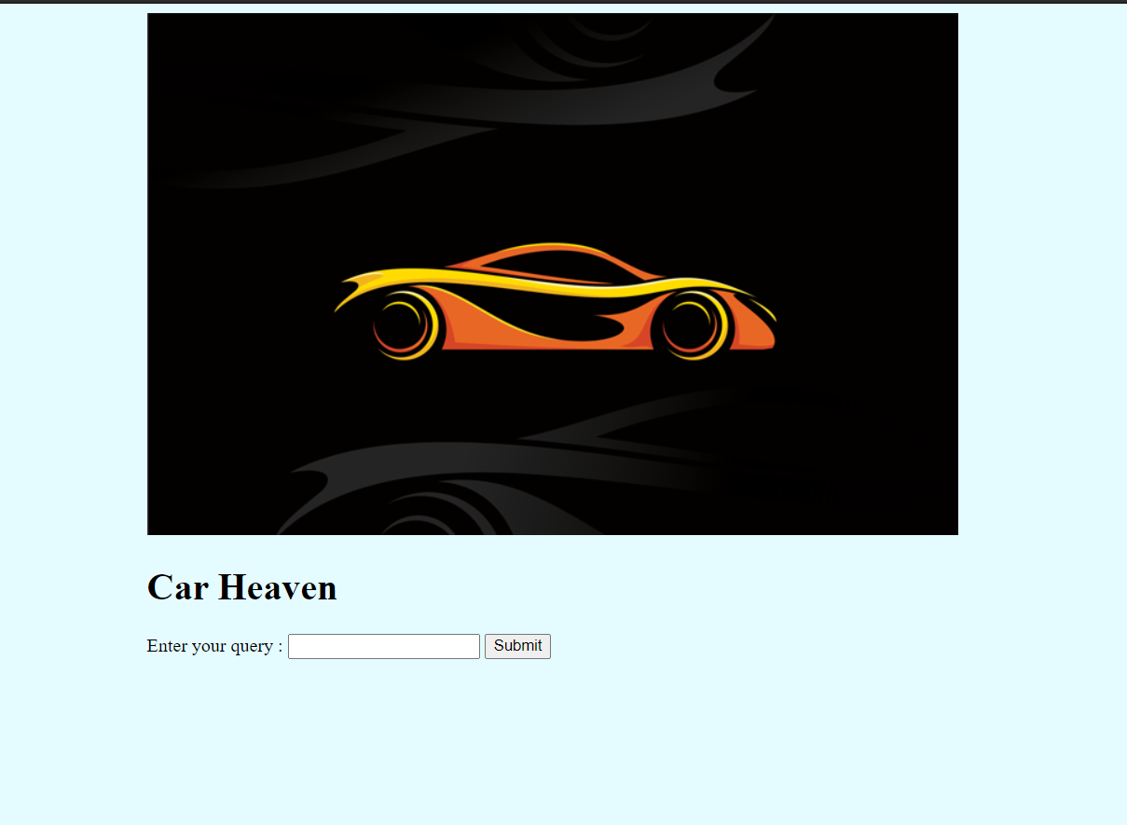
Application

Slide 10
References
https://www.truecar.com/
https://plugstar.com/
https://www.macrotrends.net/stocks/charts/TRUE/truecar/profit-margins
https://www.washingtonpost.com/business/2021/01/28/us-economy-recession/
https://finance.yahoo.com/quote/TRUE/financials/
https://www.cnbc.com/2021/01/14/with-a-lot-of-optimism-and-vaccine-hopes-us-auto-sales-could-increase-as-much-as-10percent-in-2021.html
https://www.consumeraffairs.com/automotive/truecar.html

